Slide 1

Emergency contraception: a guideline for service provision in Europe
June 2014

Slide 2
ECEC mission
To expand knowledge about and access to EC in European countries, and to promote the standardization of EC service delivery in the European context in order to ensure equitable access within the region.
Notes:
This guideline template was developed by the European Consortium for Emergency Contraception (ECEC).
The European Consortium for Emergency Contraception is a network of individuals and organizations that aim to increase knowledge and access to emergency contraception in Europe. Visit the ECEC website to learn more (www.ec-ec.org) and contact us (info@ec-ec.org) to join the online community.

Slide 3
Why a new guidelines template?
ECEC assessed EC guideline availability in European Union countries in 2012-2013. Main findings:
  5 countries do not have any guidelines.
  11 countries have guidelines that do not include UPA EC.
  11 countries have up-to-date guidelines, mostly issued by OB/GYN societies.
  General practitioners and pharmacists are rarely involved in the development of guidelines.
Notes:
ECEC developed this guidelines template to promote service delivery harmonization in Europe.
While EC options are expanding in most European countries, not all EC regimens are directly and equally accessible to women (UPA is Rx, Cu-IUD).
In 2012-13 ECEC conducted an assessment of guideline availability in 27 European Union states, which showed that many EU countries don’t have up-to-date published guidelines. (See: http://www.ec-ec.org/custom-content/uploads/2014/03/ECEC_EC-Guidelines-in-EU-countries_Feb2014.pdf)
ECEC produced this template to help national partners in the development or updating of emergency contraception guidelines according to the best available evidence to date.

Slide 4
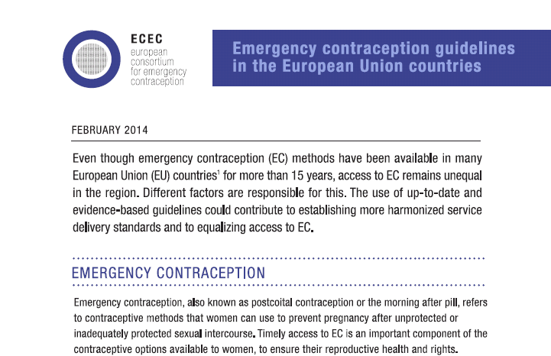
Read more about updated guideline availability at:
www.ec-ec.org/emergency-contraception-in-europe/guidelines/
Notes:
See ECEC factsheet for further details on guideline availability in EU countries:
http://www.ec-ec.org/custom-content/uploads/2014/03/ECEC_EC-Guidelines-in-EU-countries_Feb2014.pdf.

Slide 5
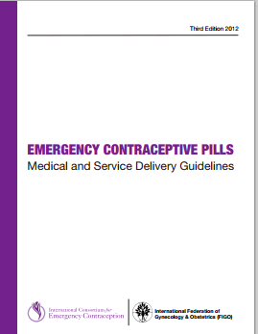
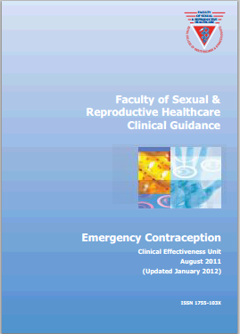
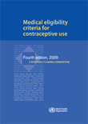
Evidence-based
Notes:
How was this template developed?
Development of first draft by Dr. Webb in March 2013 based on most updated, evidence-based guidelines: FIGO/ICEC, WHO and UK Faculty of Sexual and Reproductive Healthcare guidelines.
ECEC wanted to develop a template that can be adapted at the country level.
ECEC wanted it to be a short document with recommendations on key issues to make it useful to practicing clinicians who would be seeing women requesting EC.

Slide 6
Participatory review
First draft reviewed by:
  ECEC Board
  ECEC Advisory Committee
  Clinical Effectiveness Unit, Faculty of Sexual and Reproductive Healthcare (UK)
  International Consortium for Emergency Contraception (ICEC)
Final draft reviewed and approved by the European Society of Contraception and Reproductive Health Internal Scientific Committee in January 2014.
Notes:
During June – October 2013, additional experts reviewed draft:
ECEC Board and coordinator: Teresa Bombas, C. Fiala, Emilio Arisi, Medard Lech, and Ardian Paravani and Cristina Puig
ECEC Advisory Committee: Anna Glasier
International Consortium for Emergency Contraception (ICEC): Elizabeth Westley

Slide 7

The guideline
Methods included:
LNG
UPA
Cu-IUD
Published in English for now, but template available for translation and adaptation for use at the country level.
ECEC will regularly update the document.
Notes:
Content of the guide:
The guide covers Levonorgestrel EC Pills, Ulipristal Acetate EC Pills, and the use of the Cooper IUD as EC.
It does not include Mifepristone EC, although Mife EC dedicated products are available in Russia and CIS. ECEC is considering developing a special edition with Mife for this sub-region.

Slide 8
The guideline: Outline
Emergency contraceptives in Europe
How to deal with a request for EC
  Could she already be pregnant?
  Is there a risk for pregnancy?
  Are any cautions necessary?
What methods should be offered?
What issues should an EC guide address?
  Side effects, vomiting, follow up
References
Notes:
Outline of the guide

Slide 9
The guideline: Issues covered
Ongoing contraception
STI risk assessment
Can pregnancy risk be quantified?
What if he did not ejaculate?
Can EC hurt an implanted pregnancy?
Are there any age limits?
What about after rape?
Is timing of use important?
How many times can EC pills be used?
Notes:
Highlights of the guide:
It covers all the concerns that clinicians have raised or may be worried about.
The guide accidentally does not mention the ring in the section on quick starting, but it should be included.
The aim is that this will be a live document and will be kept updated.
The guide updated the ICEC recommendation on UPA and breastfeeding.

Slide 10
The guideline: Issues covered
Can breast feeders use EC pills?
Can EC increase risk of infertility, ectopic pregnancy, stroke, STIs?
Are any tests necessary?
Where should it be available?
Who can issue it?
Can professionals refuse to provide EC for personal reasons?
Can it be issued in advance?
Can it be issued to a third party?
What if there is no licensed version?
Notes:
It also looks at certain organizational issues.

Slide 11
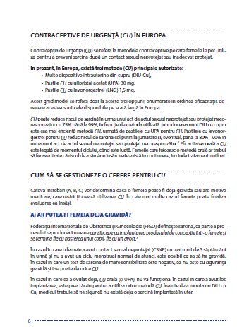
A template for national adaptation and use
Conceived as a template, to be adapted according to national legislation and product availability.
In 2014, Italy, Portugal, Romania, and Spain expressed interest in adapting this tool.
Notes:
It is important to highlight that this is a template, meant to be adapted in-country according to national legislation, product availability, etc. Not just to be translated but reviewed and adjusted to each country’s context.

Slide 12
Added value
National adaptation and review processes: key opportunity to strengthen knowledge of other gatekeepers.
ECEC recommends the adoption of participatory reviews in cooperation with national stakeholders: contraception societies, pharmacist associations, primary care representatives, OB/GYN societies, and other key organizations.
Notes:
The guide can be a tool not only for contraception professionals but for all those who play a role in accessing EC.
ECEC recommends that national reviews of this template are conducted with the involvement of pharmacist associations, primary care representatives, OB/GYN societies, and other key organizations that play a role in ensuring timely access to EC in a given country.

Slide 13
Thank you!
ECEC thanks the ESC for their financial and technical support and all the experts and ECEC colleagues who generously contributed to this effort.

Slide 14

If you are interested in using this tool in your country, contact ECEC at:
info@ec-ec.org
Download the guidelines at www.ec-ec.org
Thank you!

